Slide 1

Internet-of-Things (IoT)
Dr. Md. Sazzadur Rahman
Associate Professor
IIT-JU

Slide 2
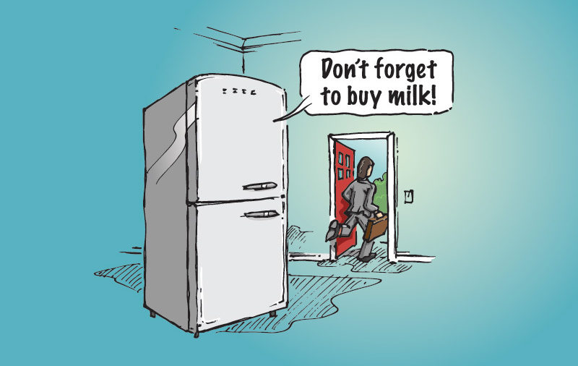

What is the Internet-of-Things?

Slide 3
How Does My Fridge Do That?
You are leaving the home (sense user)
There’s no milk in fridge (sense object)
Use this information to make a decision (process)
Inform user of decision (communicate)

Slide 4
How Does My Fridge Do That?
You are leaving the home (sense user)
What type of sensor?
Distinguish between parent and child
Identify reason for leaving home
Identify other contexts (e.g., store hours)
There’s no milk in fridge (sense object)
Use this information to make a decision (process)
Inform user of decision (notify)

Slide 5
How Does My Fridge Do That?
You are leaving the home (sense user)
There’s no milk in fridge (sense object)
What type of sensor?
Is milk needed?
No milk or “little” milk? (prediction)
Use this information to make a decision (process)
Inform user of decision (notify)

Slide 6
How Does My Fridge Do That?
You are leaving the home (sense user)
There’s no milk in fridge (sense object)
Use this information to make a decision (process)
Where is processor?
What are the rules?
Fixed rules versus dynamic rules (learning)
Inform user of decision (notify)

Slide 7
How Does My Fridge Do That?
You are leaving the home (sense user)
There’s no milk in fridge (sense object)
Use this information to make a decision (process)
Inform user of decision (notify)
How?
When?
Privacy?
Subtleness?
Information overflow?

Slide 8
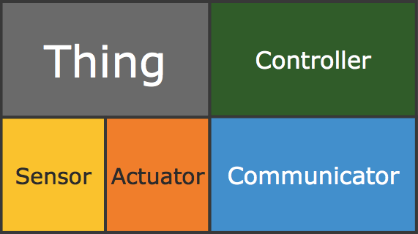
Internet-of-Things (IoT)
Physical object (“thing”)
+
Controller (“brain”)
+
Sensors
+
Actuators
+
Networks (Internet)

Slide 9
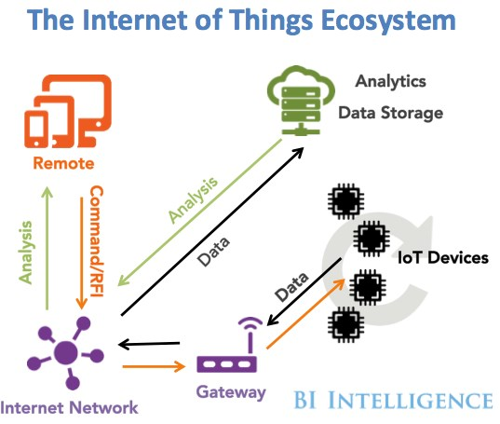
Internet-of-Things (IoT)

Slide 10
Related Areas/Terminology
Embedded systems: not necessarily connected
Sensor networks: collection of sensor devices connected through wireless channels
Cyber-physical systems: focus on interaction between physical and cyber systems
Real-time systems: focus on time constraints
Pervasive/ubiquitous computing: focus on anytime/anywhere computing

Slide 11
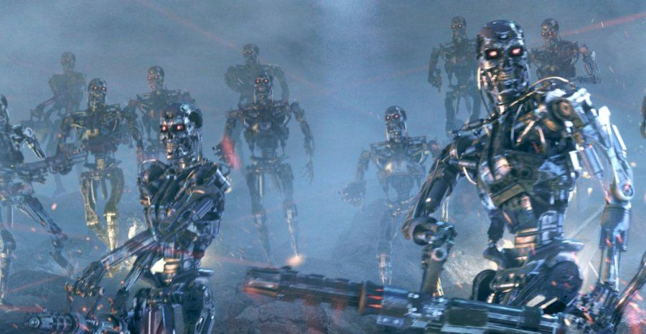
Related Areas
Machine-to-machine (M2M) communications
Internet of Everything (Cisco Systems)
“Skynet” (Terminator movie)

Slide 12
“Internet-of-Things”
Term coined by British entrepreneur Kevin Ashton, while working at MIT Auto-ID Labs
Referred to (and envisioning) a future global network of objects connected specifically by RFID (radio-frequency identification)
Complete automation of data collection
First article about IoT in 2004 from MIT; called “Internet 0”

Slide 13
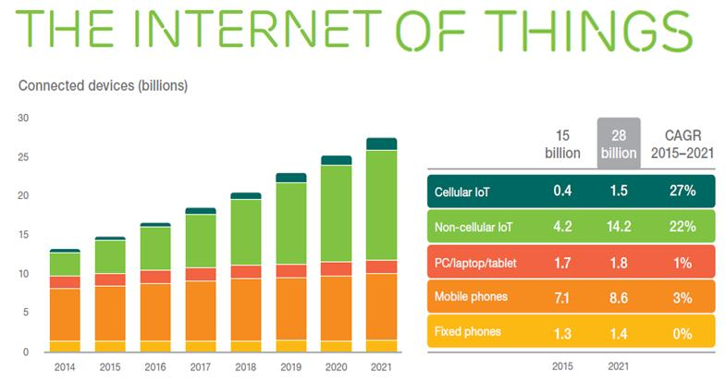
Internet-of-Things Vision & Growth

Slide 14
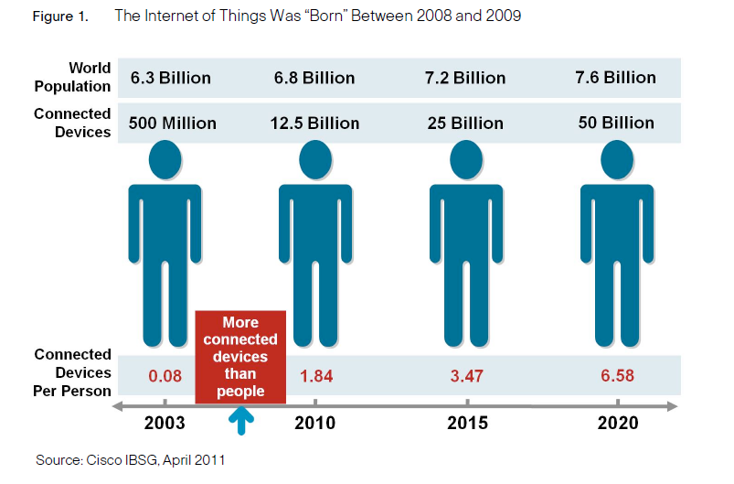
Internet-of-Things Vision & Growth

Slide 15
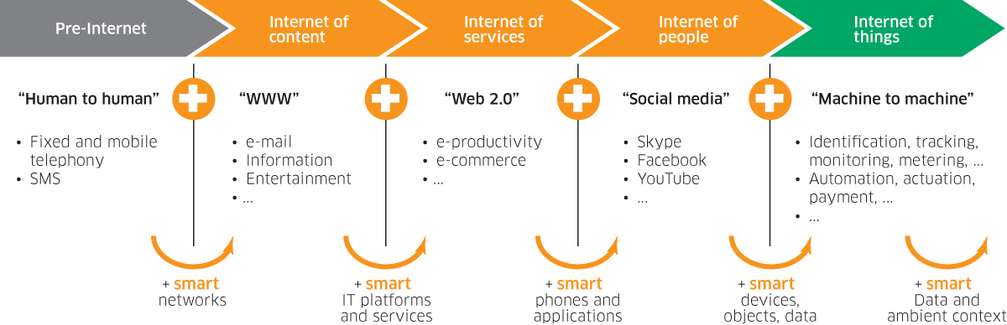
Internet-of-Things Vision & Growth

Slide 16
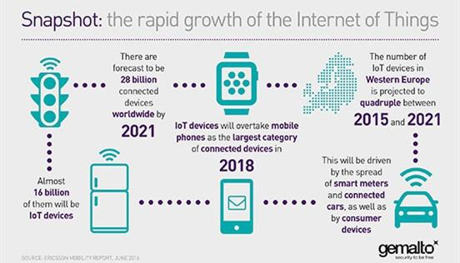
Internet-of-Things Vision & Growth

Slide 17
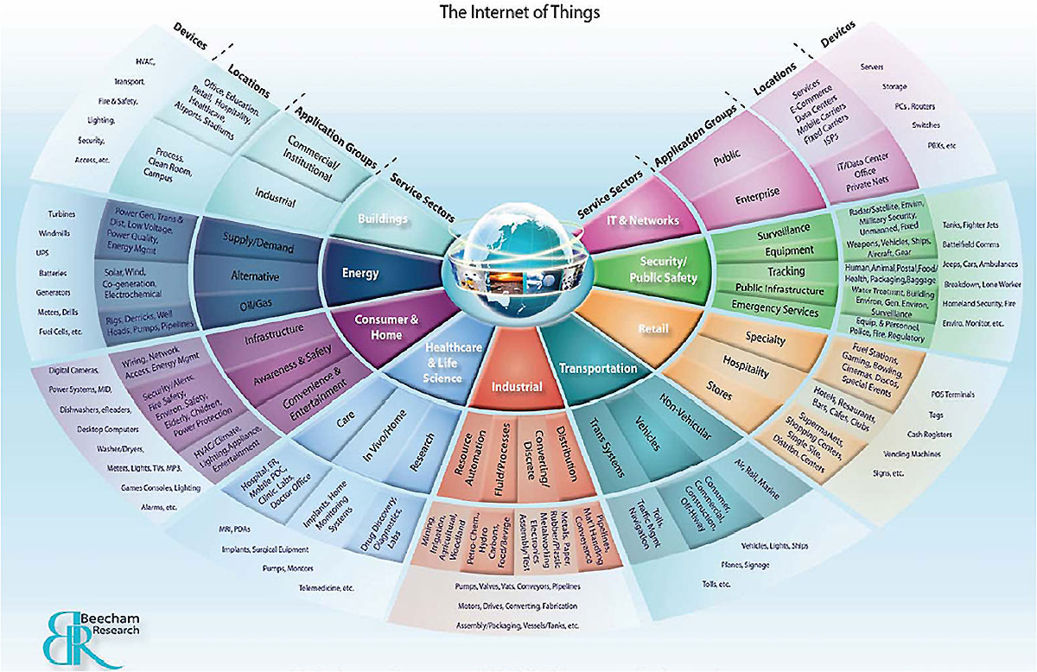
Internet-of-Things Vision & Growth

Slide 18

Cisco Commercial

Slide 19
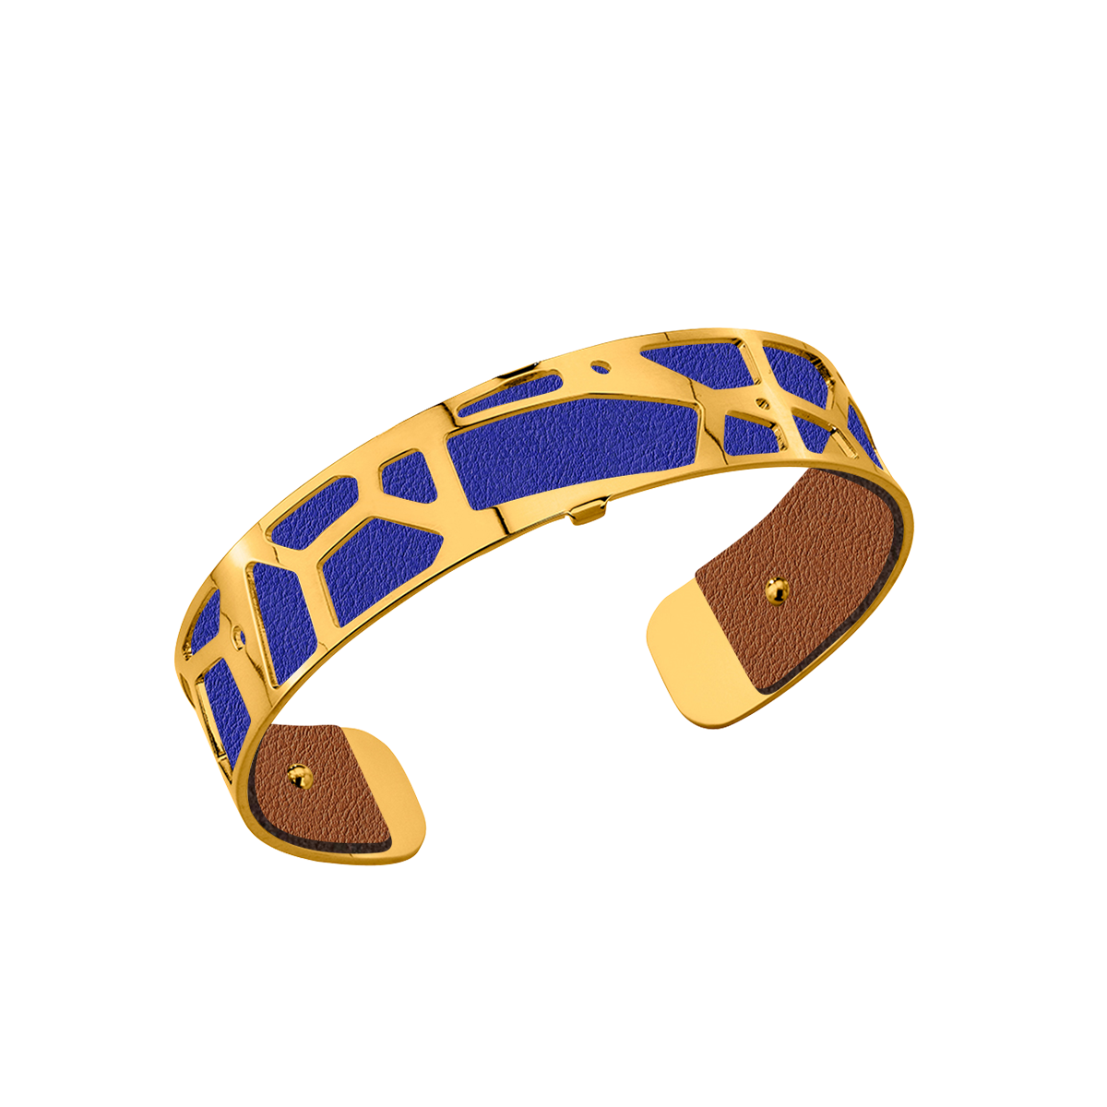
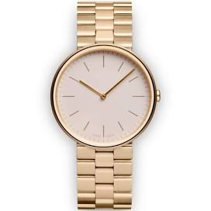
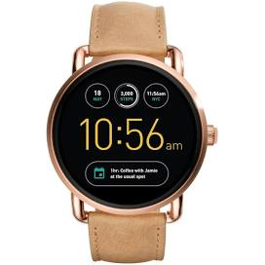
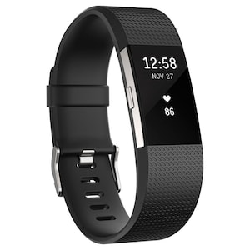
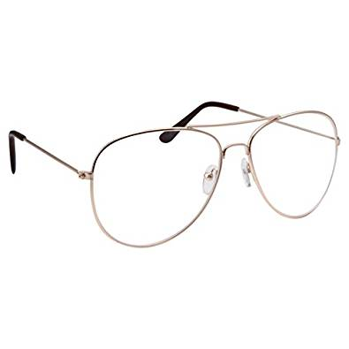
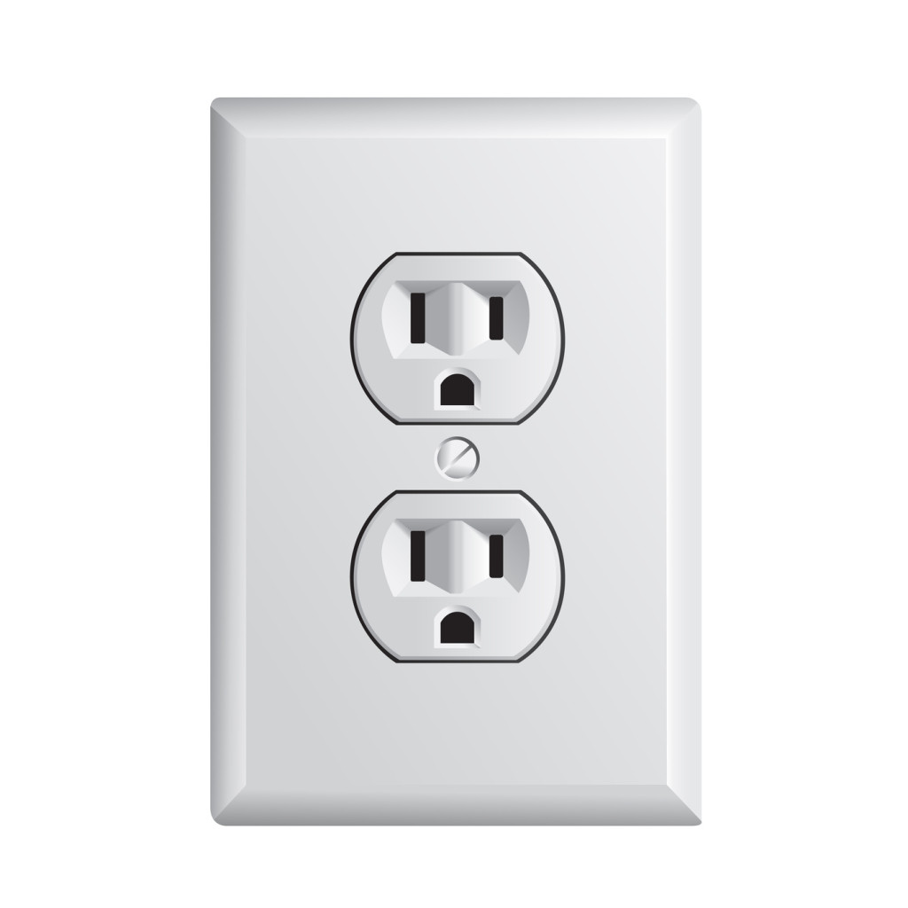
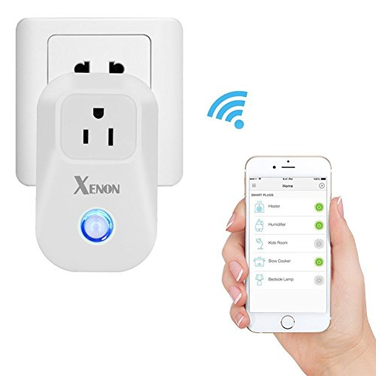
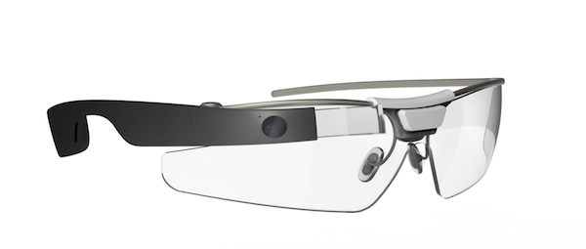
Augment Existing Things

Slide 20
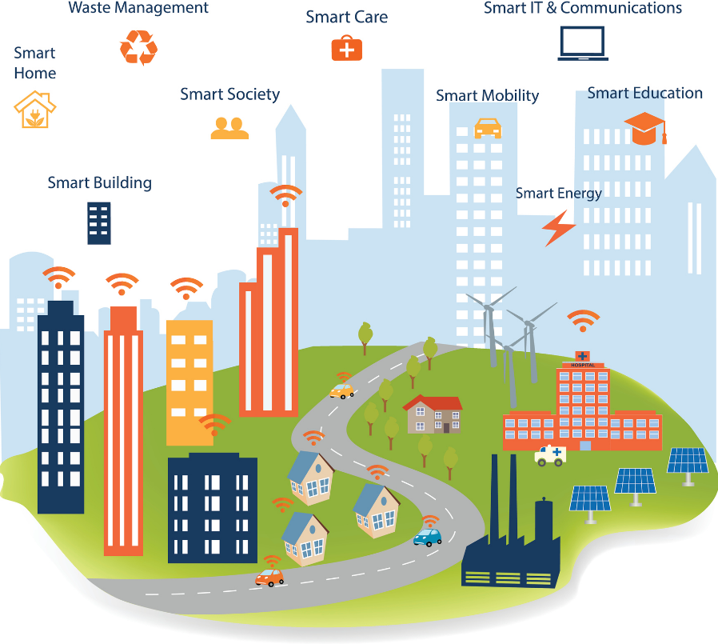
Augmenting Life With New Things
Smart City
Smart Car
Smart Me (healthcare, fitness, wellness)

Slide 21
Example: Connected Roadways
US DoT Statistics for 2012:
5.6million crashes
About 31,o00 fatalities (26,500 in EU)
Over 1.6M injuries
1trillion USD in economic loss
5.5billion hours of travel delays per year
CO2 emissions

Slide 22
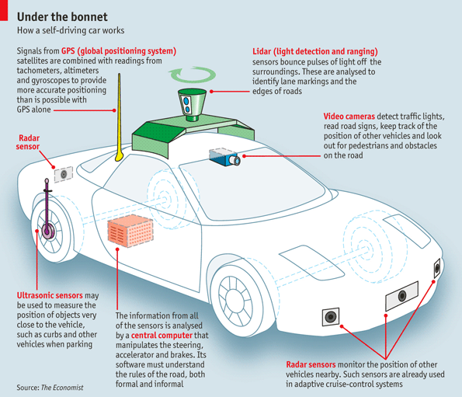
Example: Connected Roadways

Slide 23
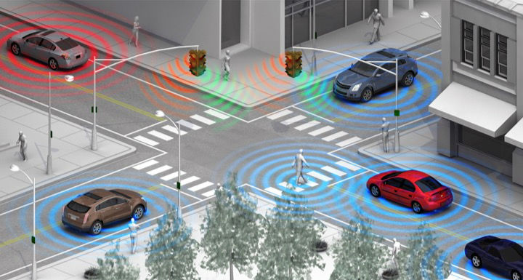
Example: Connected Roadways
State of Self-Driving Car

Slide 24
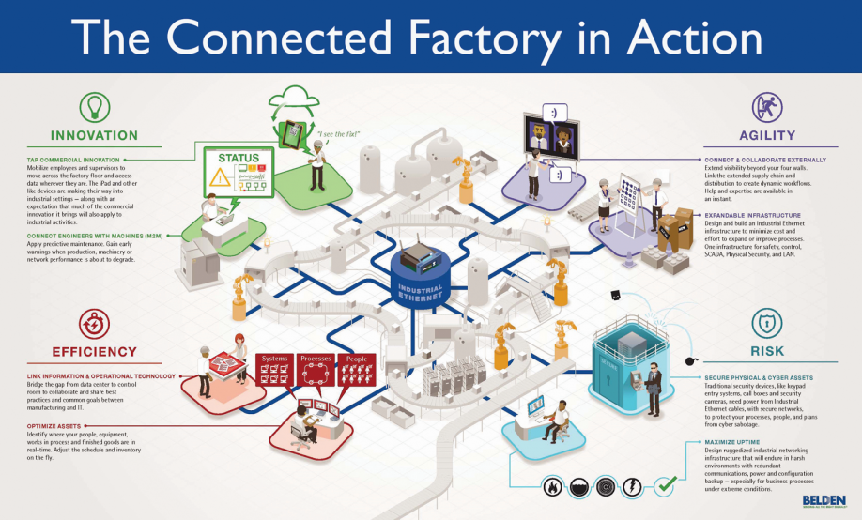
Example: Connected Factory

Slide 25
Example: Connected Factory
New product and service introductions faster
Increasing production, quality, uptime
Mitigating unplanned downtime
Protecting from cyber threats
Worker productivity and safety

Slide 26
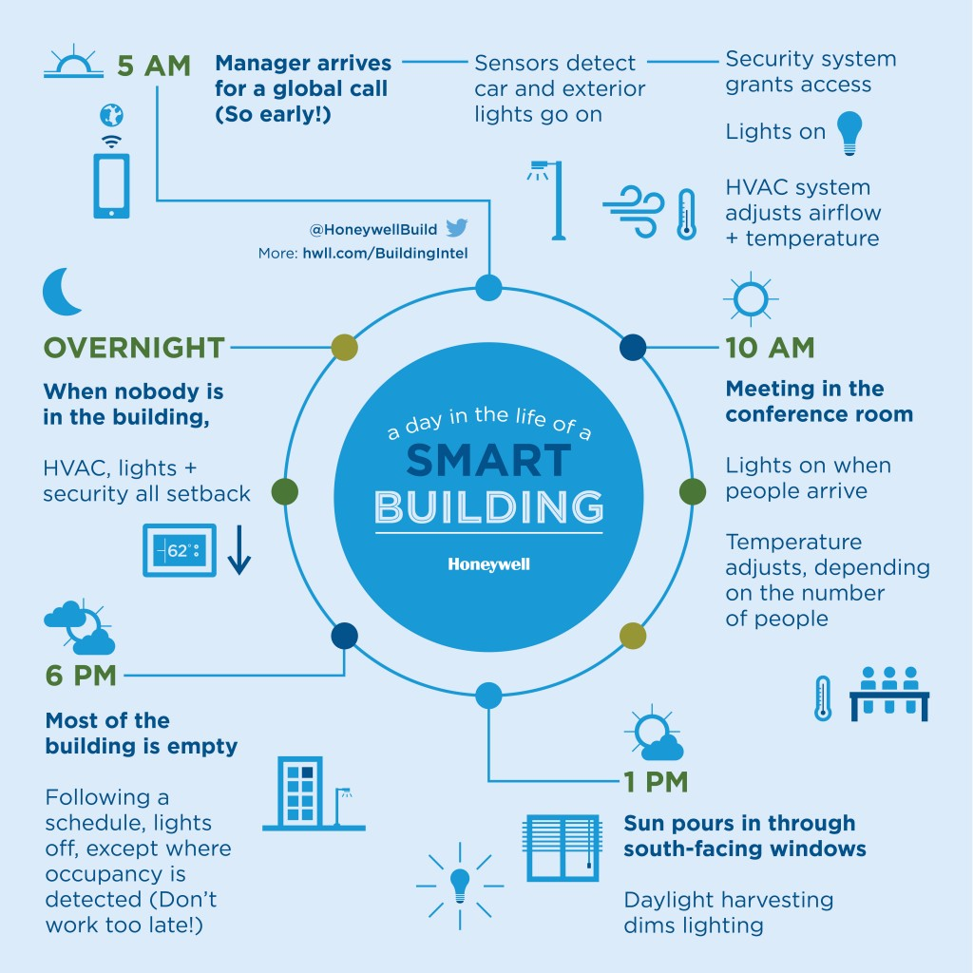
Example: Smart & Connected Buildings
Energy management
Lighting
Safety
HVAC
Building automation
Smart spaces

Slide 27
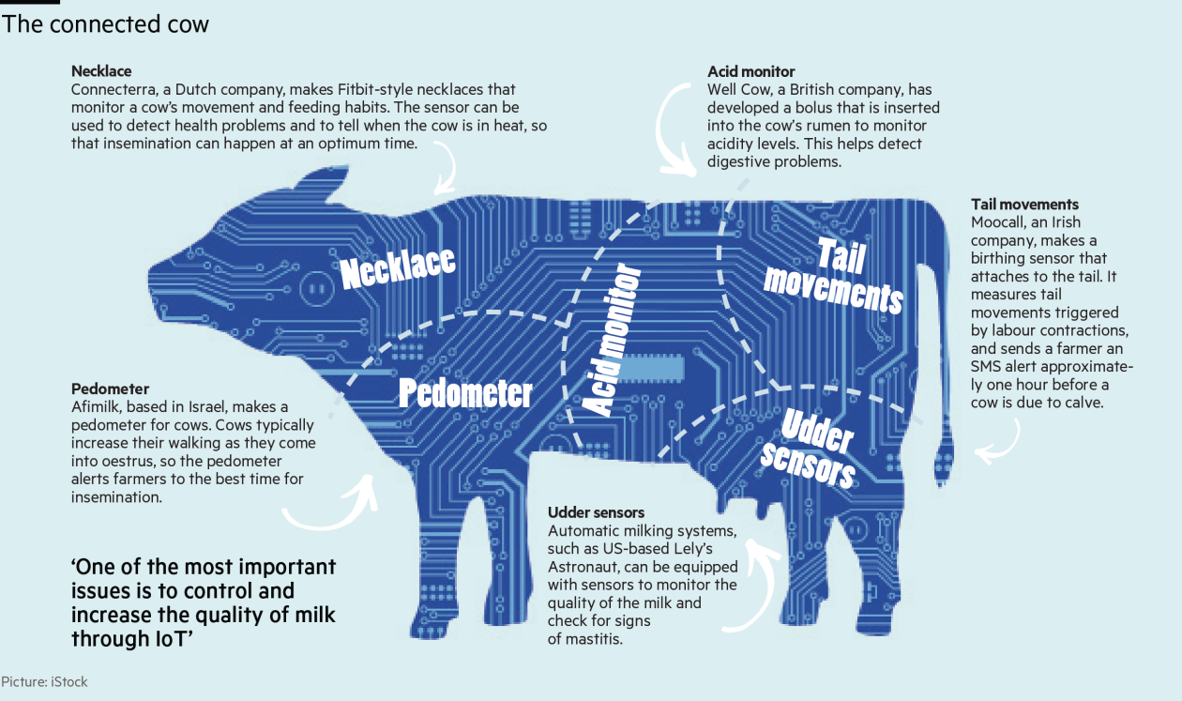
Example: Smart Creatures

Slide 28
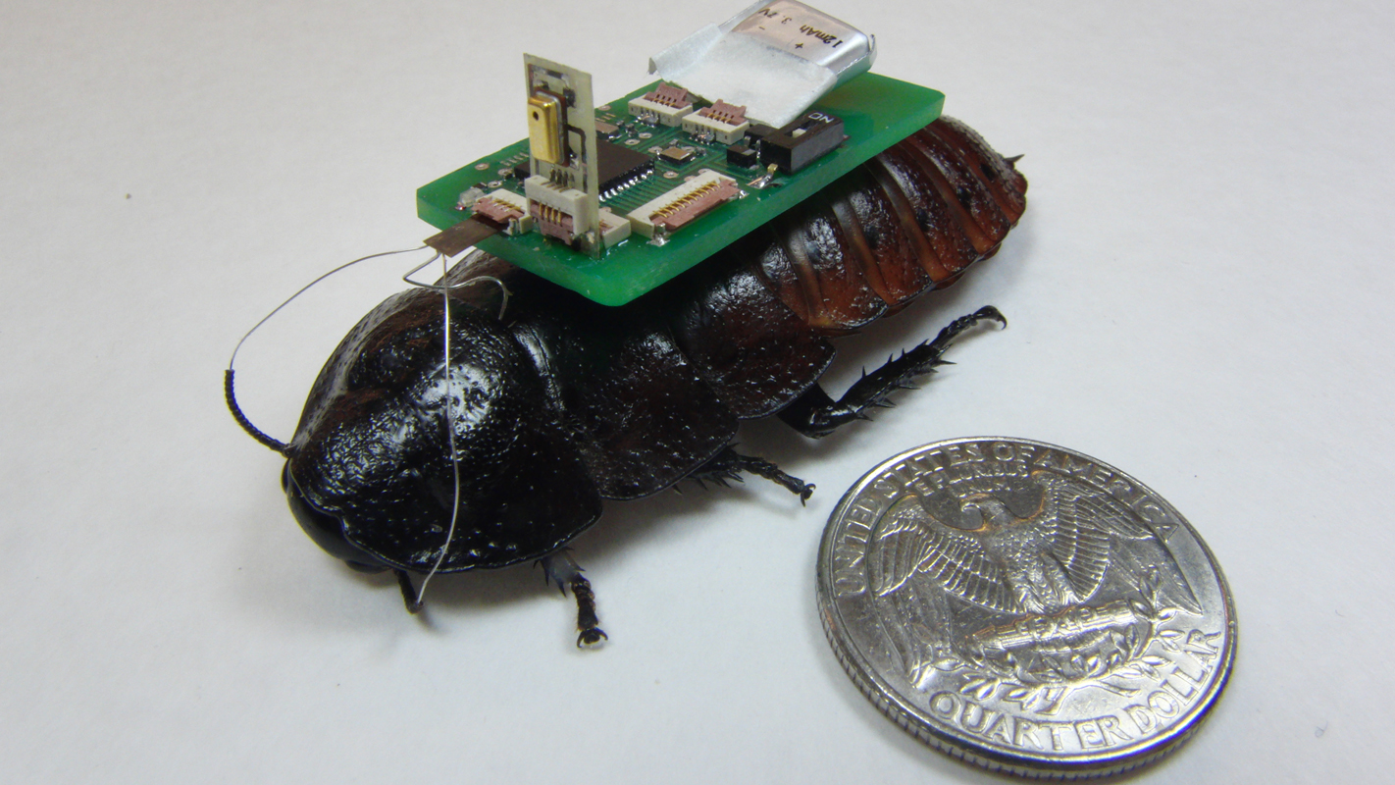
Example: Smart Creatures
IoT-Enabled Roach, NC State University

Slide 29
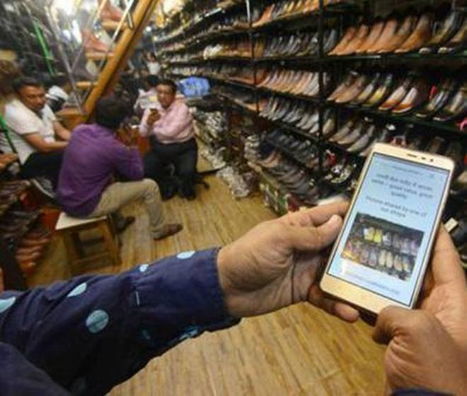
Example: Fight Poverty
Try to get more shoppers from Warden Road to Dharavi in Mumbai

Slide 30
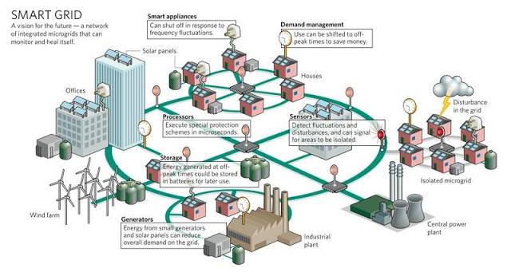
Example: Smart Grid

Slide 31
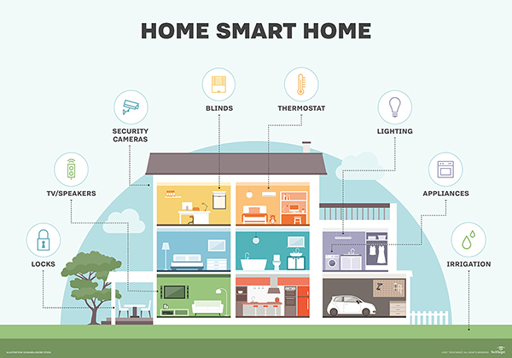
Example: Smart Homes

Slide 32
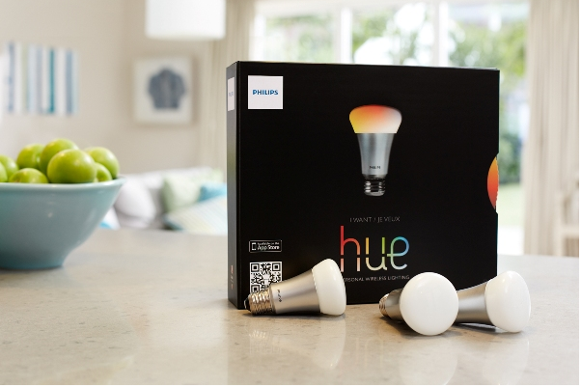
Example: Smart Lighting
Tunable light, 16 million colors
Activated by smartphone or over Zigbee wireless
Can serve as alarm clock
Can synch colors to movies or possibly music
Philips never anticipated the demand - sold out in 3 months at Apple stores!

Slide 33
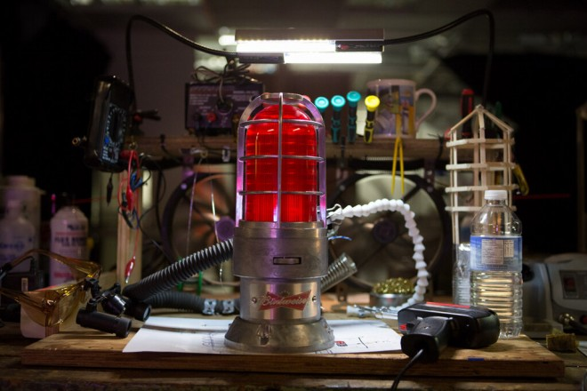
Example: Wi-Fi Connected Goal Light
In-Home Automatic Hockey Goal Light (Budweiser)

Slide 34
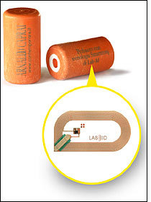
Example: Smart Corks
Smart Corq: allows wine producers and consumers to have greater assurance of the quality and provenance of each bottle of wine
Bottling date
Grape type
Alcohol percentage
and more…

Slide 35
More Smarts
Smart bathroom cabinet for medicine
Smart refrigerator
Smart toilet
Smart history (in museums)
Smart health (sensors in running shoes)
Smart buying (beacons)
Smart shirt (seal wounds)
Smart helmet (detect concussion)
…

Slide 36
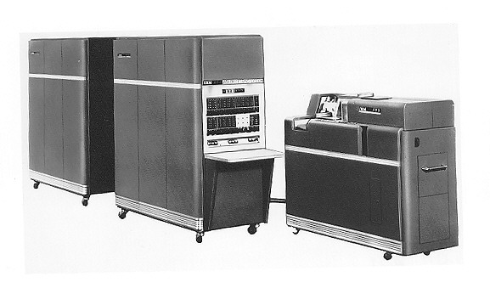
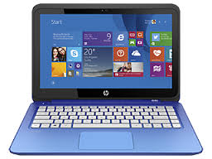
Enablers: Portability
Reducing the size of hardware to enable the creation of computers that could be physically moved around relatively easily

Slide 37
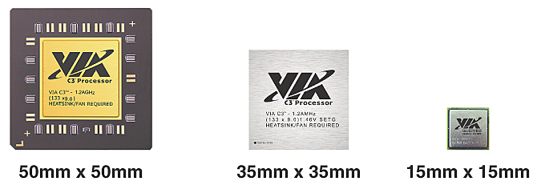
Enablers: Miniaturization
Creating new and significantly smaller mobile form factors that allowed the use of personal mobile devices while on the move

Slide 38
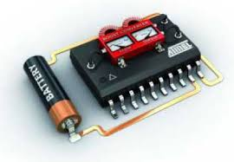
Enablers: Low Power and Low Heat
Low power architectures
Low power radios
Sleep modes
Energy harvesting

Slide 39
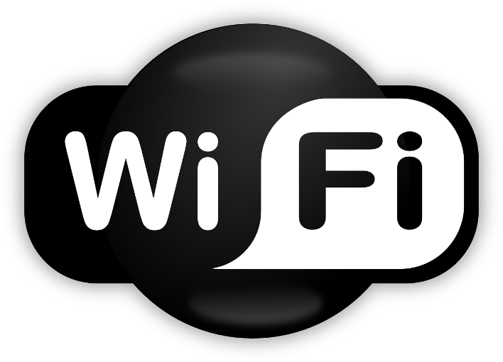
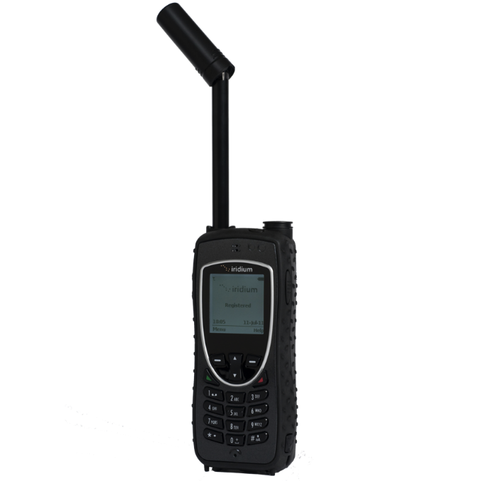

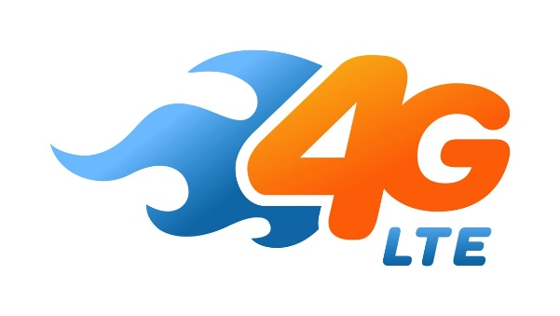
Enablers: Connectivity
Developing devices and applications that allowed users to be online and communicate via wireless data networks while on the move

Slide 40
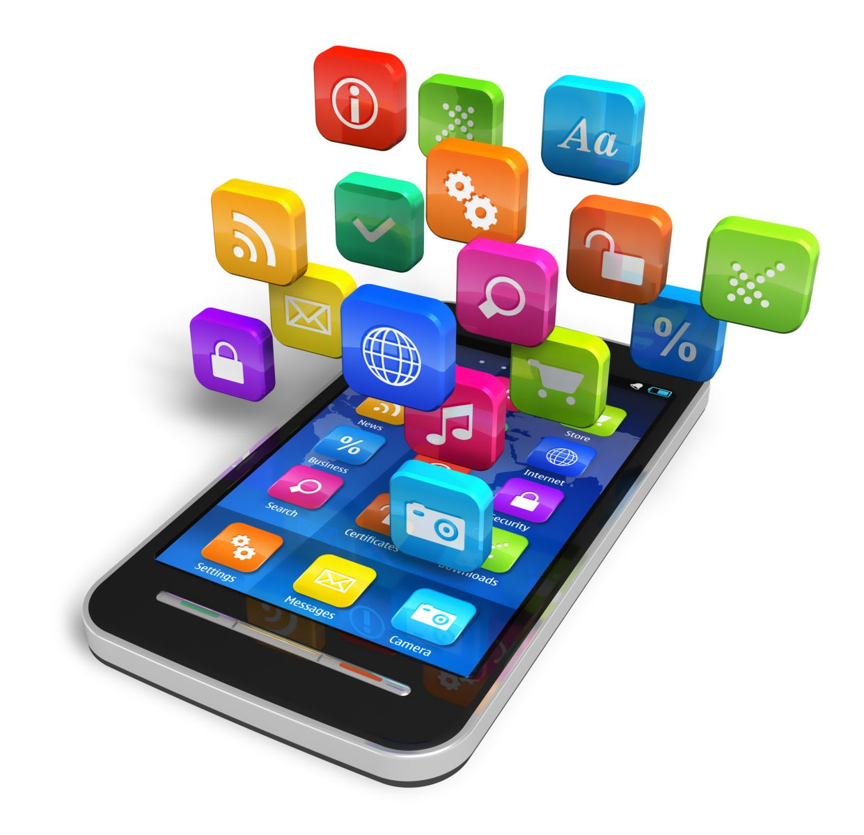
Enablers: Convergence
Integrating emerging types of digital mobile devices, such as Personal Digital Assistants (PDAs), mobile phones, music players, cameras, games, etc., into hybrid devices

Slide 41
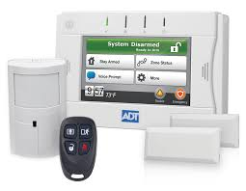
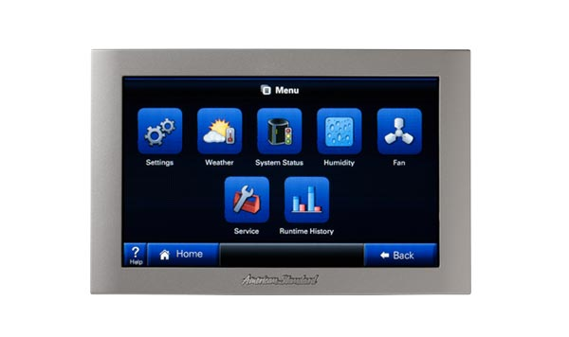
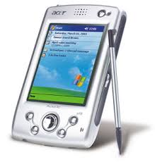
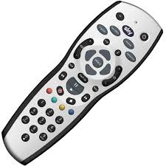
Enablers: Divergence
Opposite approach to interaction design by promoting information appliances with specialized functionality rather than generalized ones

Slide 42
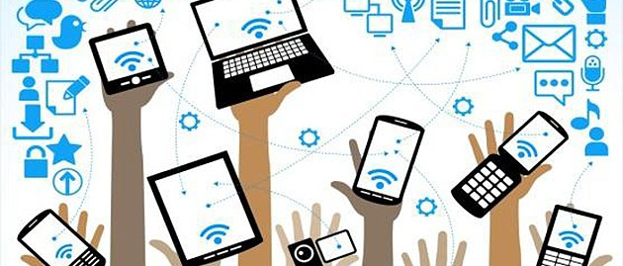
Enablers: Ecosystems
The emerging wave of digital ecosystems is about the larger wholes of pervasive and interrelated technologies that interactive mobile systems are increasingly becoming a part of

Slide 43
Example: Smartphone
Portability: carry it anywhere you want
Miniaturization: make it possible to build device to fit in your pocket
Connectivity: Wi-Fi, LTE/4G, cellular, Bluetooth
Convergence: phone, camera, gaming device, movie streaming, music player, …
Digital Ecosystem: cloud, social networks, software development kits, app stores, big data, standardization …

Slide 44
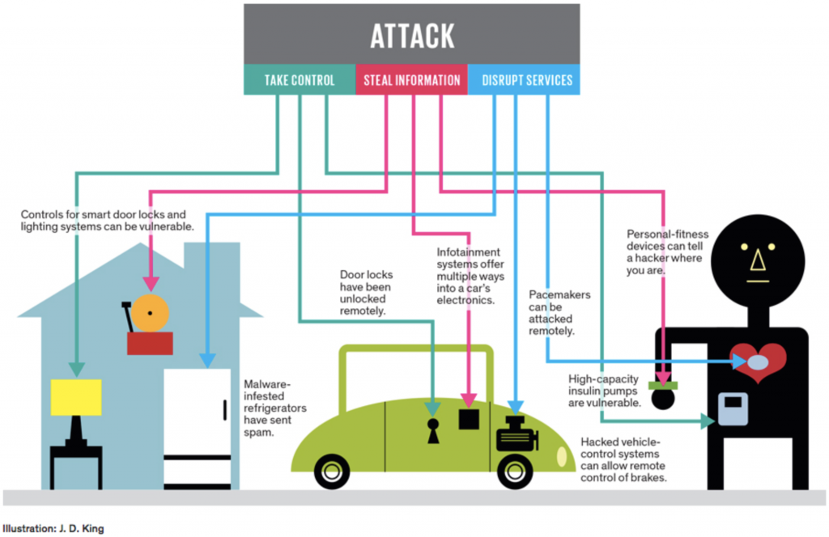
IoT Issues & Challenges

Slide 45
Reaction to Commercial
One Perspective
“Coke commercial about security cameras was so cool. Let's look at the world a little differently. Going to drink a coke in honor.”
Another Perspective
“Ad full of hidden security-cam moments: Coke proudly proclaims itself official soft drink of the security state.”

